Slide 1
How to Switch Adapt a Plush Toy

Slide 2
Intro
This presentation includes the general procedure and a visually detailed step by step set of instructions of how to adapt the basic battery operated plush toy
In this presentation, at the bottom of each slide, there are additional typed instructions for the adaptation process that can be found in the speaker notes (see speaker notes for this slide as an example)
All typed instructions from the speaker notes can be found in this document
This presentation was made by Big Red APDI (contact bigredapdi@gmail.com)
Notes:
speaker notes: This tab here is where the typed instructions for each step in the adaptation process can be found

Slide 3
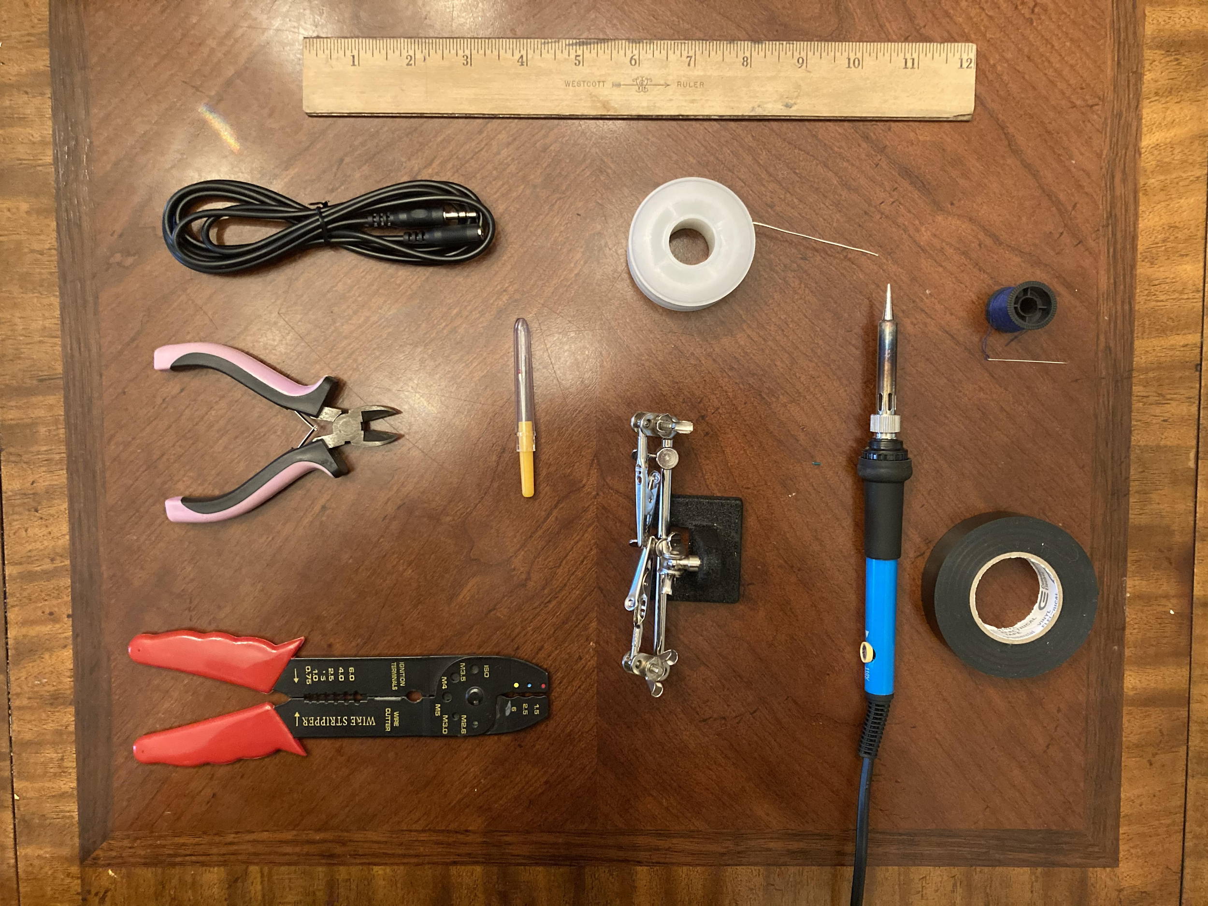
Materials
Battery operated plush toy
Soldering Kit (or solder gun)
Sewing Kit
3.5mm Female Jack to Stereo Cable
Wire Cutter/Wire Stripper (can use scissors)
Electrical Tape (or other tape)
Adjustable Helping Hands (optional)
Ruler (optional)
Big Red APDI, bigredapdi@gmail.com
Notes:
All materials listed above have links to all the products that I used to adapt the plush toy in this presentation

Slide 4
Process of Adaptation for Plush Toys
Schematic showing toy wiring prior to adaptation
Schematic showing toy wiring after adaptation
Big Red APDI, bigredapdi@gmail.com
Notes:
These two images correspond to the first and last steps in the process of adaptation for the wiring for adapting the plush toy

Slide 5
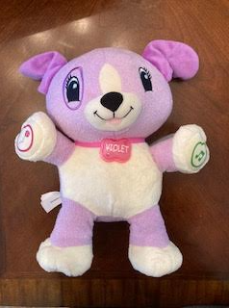
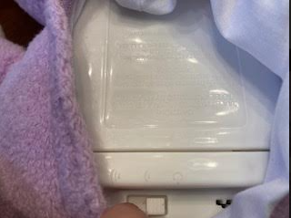
Choosing the Appropriate Plush Toy and Turning it Off
Off
Notes:
Choose a plush toy that has a button that you would normally press to turn on the toy (make sure the toy’s exterior isn’t made of plastic or the button isn’t surrounded by plastic as that is a different type of adaptation) and turn the toy off

Slide 6
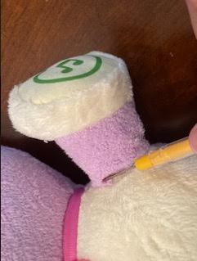
Ripping Open the Seam Near the Button of the Toy
Notes:
Use the seam ripper to to cut through the fabric and rip open the seam near the internal switch of the toy

Slide 7
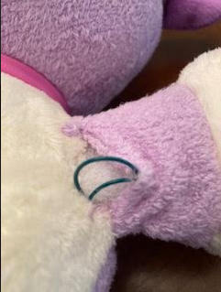
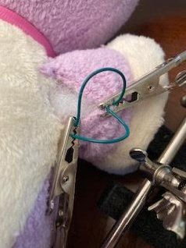
Fishing out the 2 Wires and Holding them in Place
Notes:
Fish out the 2 wires within the toy connecting the battery compartment to the internal switch
Use the helping hands tool to help hold the wires in place with the alligator clips

Slide 8
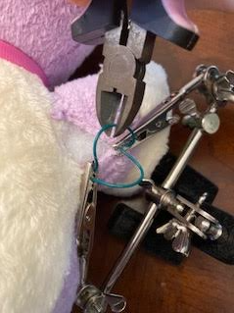
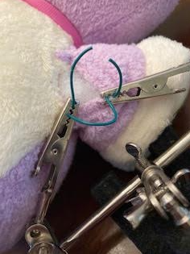
Cutting 1 Wire at the Halfway Point
Notes:
Use wire cutters/scissors to cut one wire from the 2 found within the toy at the halfway point in the loop

Slide 9
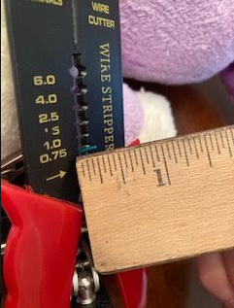
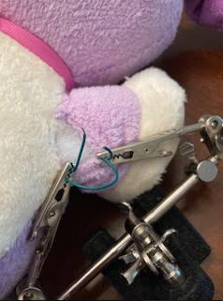
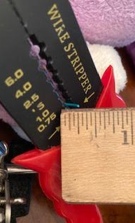
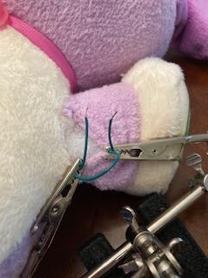
Stripping 1/4” Off the 2 Ends of the Cut Wire
¼
Ruler to scale in regular view
1/4”
1/4”
Notes:
Use the wire stripper to strip 1/4” off both ends of the wire that was cut in the previous step to show small strands of copper wire at each end of the wires

Slide 10
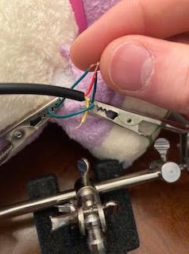
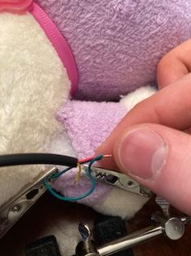
Twisting the 2 Stripped Wires and the Red Wire Copper Ends Together
Notes:
Use your fingers to twist the 2 copper strand containing ends together with the copper strands at the end of the red insulated wire all together as tight as possible

Slide 11
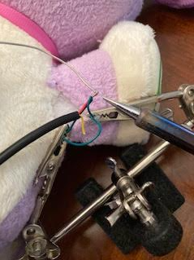
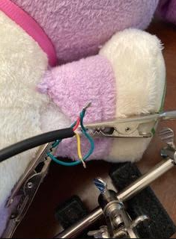
Soldering the Copper Ends of the 3 Intertwined Wires
Notes:
Press the solder (metal wire) into the tip of the soldering iron directly on top of the exposed copper strands at the end of the 3 twisted copper wires (including the red wire)to cover the copper with a small bulb of solder

Slide 12
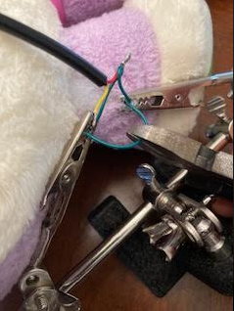
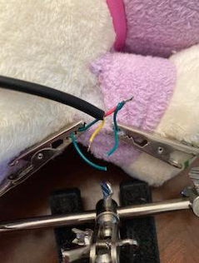
Cutting the Other Wire at the Halfway Point
Notes:
Use wire cutters/scissors to cut the other wire from the 2 found within the toy at the halfway point in the loop

Slide 13
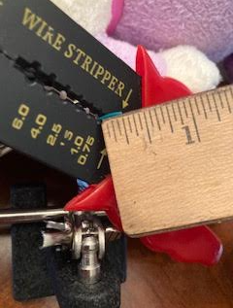
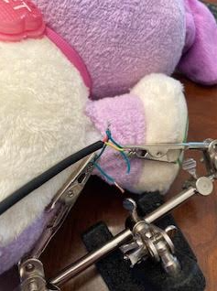
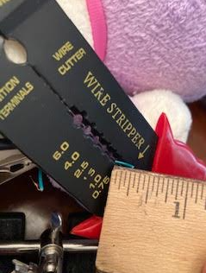
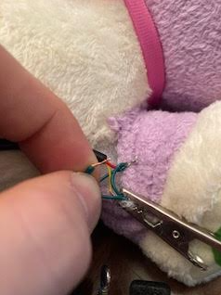
Stripping 1/4” Off the 2 Ends of the Cut Wire
¼
Ruler to scale in regular view
1/4”
1/4”
Notes:
Use the wire stripper to strip 1/4” off both ends of the wire that was cut in the previous step to show small strands of copper wire at each end of the wires

Slide 14
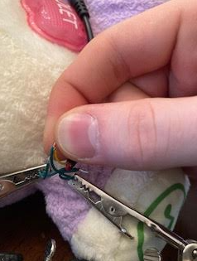
Twisting the 2 Stripped Wires and the Yellow Wire Copper Ends Together
Notes:
Use your fingers to twist the 2 copper strand containing ends together with the copper strands at the end of the yellow insulated wire all together as tight as possible

Slide 15
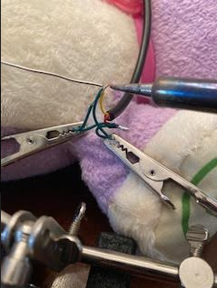
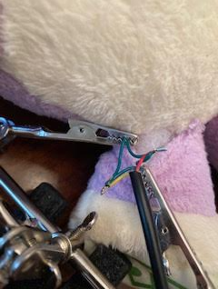
Soldering the Copper Ends of the 3 Intertwined Wires
Notes:
Press the solder (metal wire) into the tip of the soldering iron directly on top of the exposed copper strands at the end of the 3 twisted copper wires (including the yellow wire) to cover the copper with a small bulb of solder

Slide 16
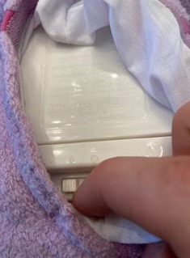
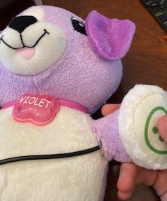
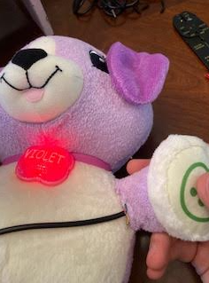
Test the Toy with the Internal Switch
On
Notes:
Turn the toy back on and test to see if it works by pressing the switch in the toy. If the adaptation is performed correctly, the toy will activate and function normally. If the toy does not correctly function, refer to slide 28.

Slide 17
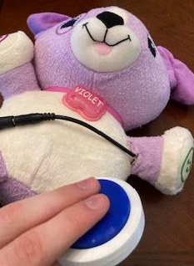
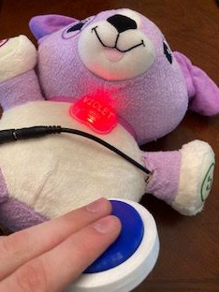
Test the Toy with an External Switch
On
Notes:
Turn the toy back on and test to see if it works by plugging an external switch into the female end of the cable. If the adaptation is performed correctly, the toy will turn on and function in the same manner when activating the toy with the interior switch. If the toy does not correctly function, refer to slide 28.

Slide 18
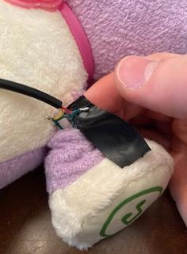
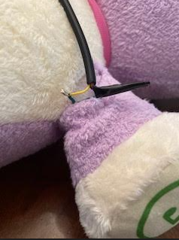
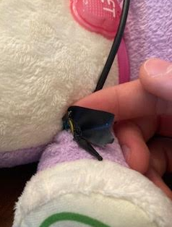
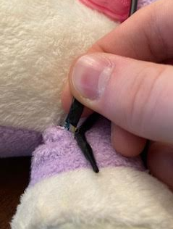
Covering up the Solder Points with Electrical Tape
Notes:
Wrap some electrical tape around the two separate solder points in the wires and press down to ensure the tape sticks tightly to the connection.

Slide 19
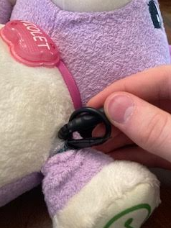
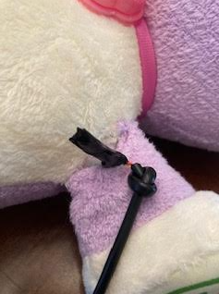
Making a Knot in the Cable and Inserting the Wires Back into the Toy
Notes:
Make a small knot in the cable by looping the female end through the same cable and insert the wires back into the toy with the knot positioned near the toy’s interior surface

Slide 20
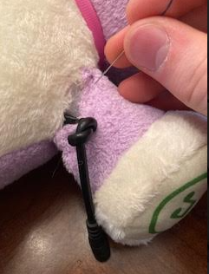
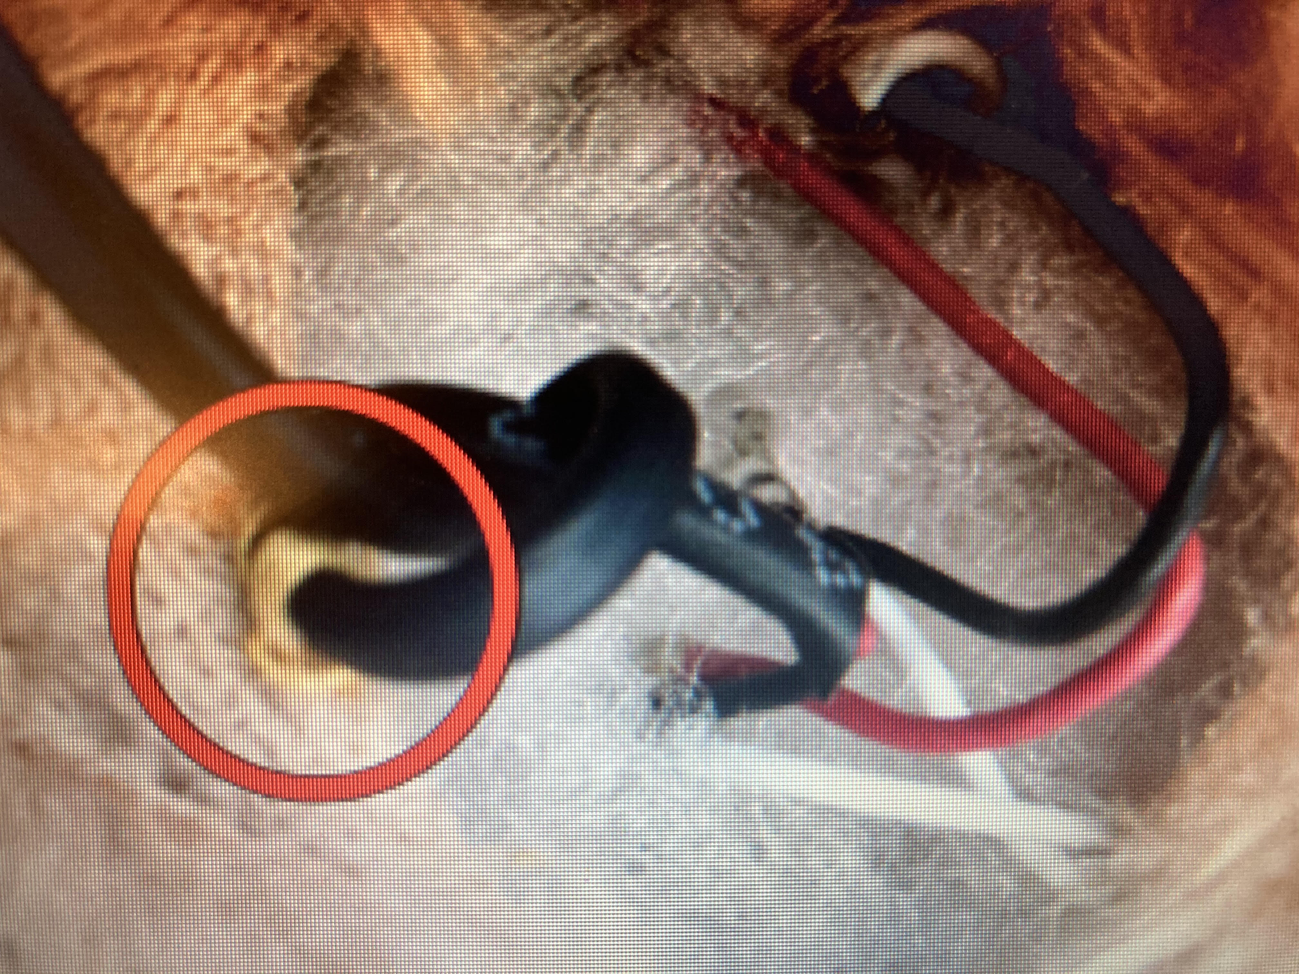
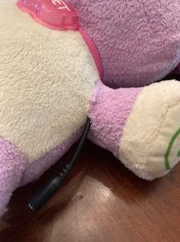
Sewing the Ripped Seam and Sewing the Knot to the Fabric
Notes:
Use a needle and thread to close up the seam in a regular stitching fashion but when reaching the knot, stitch the knot to the interior fabric of the toy in a way so that if the end of the cable is pulled, instead of the stress being placed on the interior wires, the knot and interior of the fabric is pulled

Slide 21
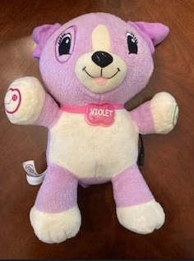
Test the Finished Product Again
Notes:
Test the functionality of the toy again by activating it with the internal switch as well as an external switch. If the toy functions correctly both ways, then the adaptation process is complete. If the toy does not function correctly, proceed to the next slide

Slide 22
Fixing Errors
If the toy begins to turn on randomly without being activated by a switch, the most likely error is that the 2 solder connection points are coming in contact with each other (see slide 22)
If the toy activates with only the interior switch but not the exterior switch, the most likely error is that the original 2 wires within the toy are properly connected but the 2 wires from the female cable are not connected to the circuit within the toy (see slides 4, 13-21)
If the toy activates with only the exterior switch but not the interior switch, the most likely error is that the 2 wires from the female cable are properly attached to the 2 wires coming from the battery compartment in the toy and the 2 wires originally connecting to the switch in the toy are not connected in the circuit (see slides 4, 13-21 )
If the error doesn’t relate to any of the errors above and still doesn’t work, refer to each of the previous slides to carefully troubleshoot the error

Slide 23
Closing remarks
If you enjoyed this presentation today and are interested in our cause or donating to our cause, please consider donating to our gift account (https://bigredapdi.wixsite.com/home/funding)
Thank you!!!
Any Questions?
Contact: bigredapdi@gmail.com

